Slide 1
SEC555
Presentation based on SEC555: SIEM with Tactical Analytics
Achieving SIEM Visibility and Detection with Data that Matters
Justin Henderson (GSE # 108)
@SecurityMapper

Slide 2
About Me
Author of SEC555: SIEM with Tactical Analytics
GIAC GSE # 108, Cyber Guardian Blue and Red
61 industry certifications (need to get a new hobby)
Two time NetWars Core tournament winner (offense)
And security hobbyist and community supporter
Release research to the community
See https://github.com/HASecuritySolutions

Slide 3
Welcome!
A copy of this talk is available at: https://github.com/HASecuritySolutions/presentations
More free stuff: https://github.com/HASecuritySolutions

Slide 4
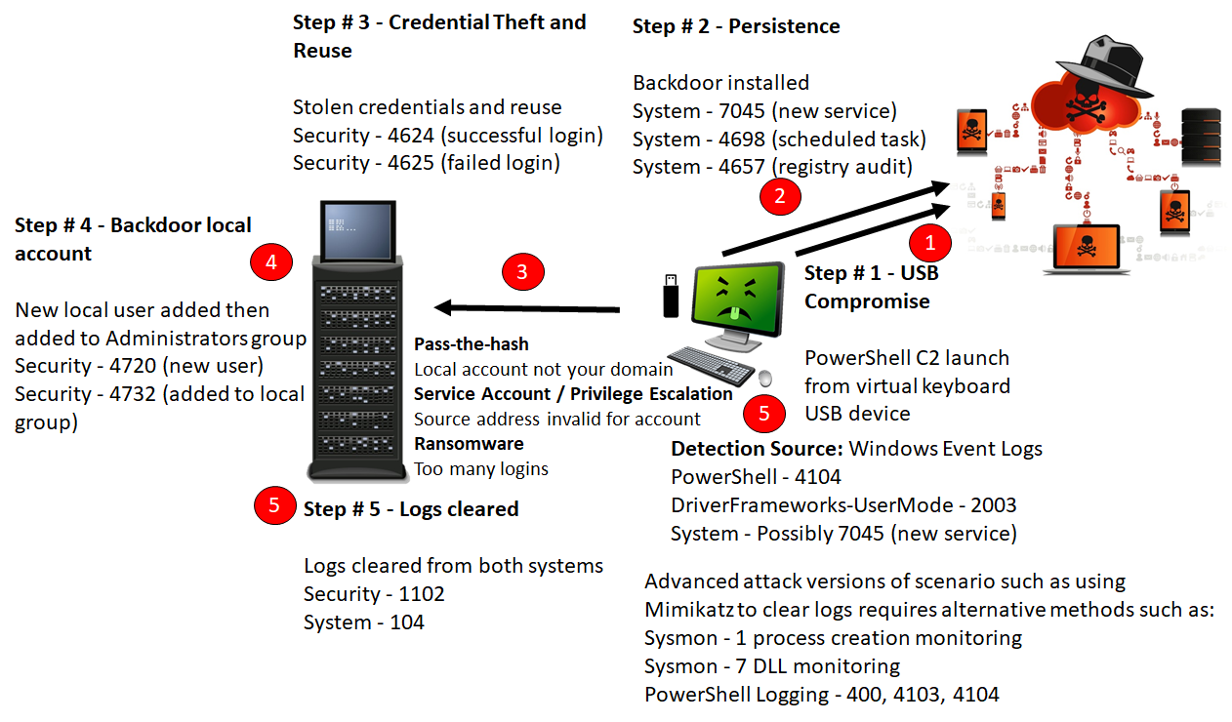
Detection Capabilities

Slide 5
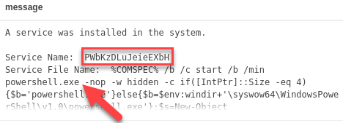
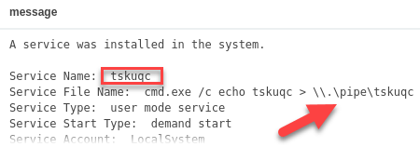
Service Creation Gone Bad (Event ID: 7045)
Common attack techniques create services
Top example is of Meterpreter compromise through PSExec
Bottom event is of privilege escalation

Slide 6
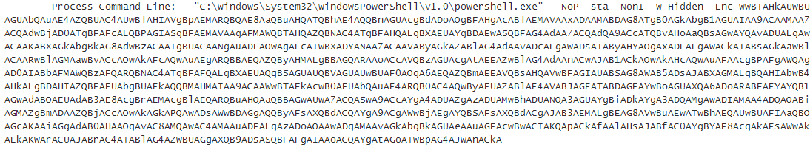
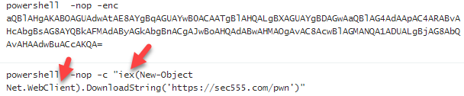
PowerShell Attacks (Event ID: 4104 or 4688)
PowerShell is now commonly used for modern attacks

Slide 7
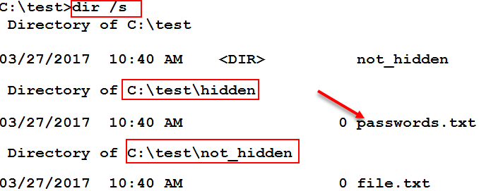
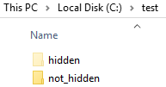
File Auditing (Event ID 4663)
Automated scripts/malware often used to find patterns
Social security #, credit card #, or drivers license
Operate by enumerating and reading through files
Often ignores hidden folders

Slide 8
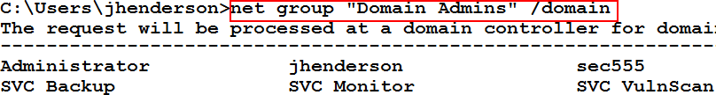
Group Querying (Event ID 4662 and 4663)
By default all users can list group members
Attackers enumerate members to find users to target
Many alternative methods to list group members
Mickey Perre has a blog on detecting this behavior
Windows auditing can capture read member requests
Combined with agent/aggregator filters = AWESOME

Slide 9

MITRE ATT&CK
Adversarial Tactics, Techniques, and Common Knowledge
Focus is on actionable detection techniques
Given common adversarial methodologies
Framework is high-level enough to report on and adapt
Yet specific enough to provide actual items to look for

Slide 10
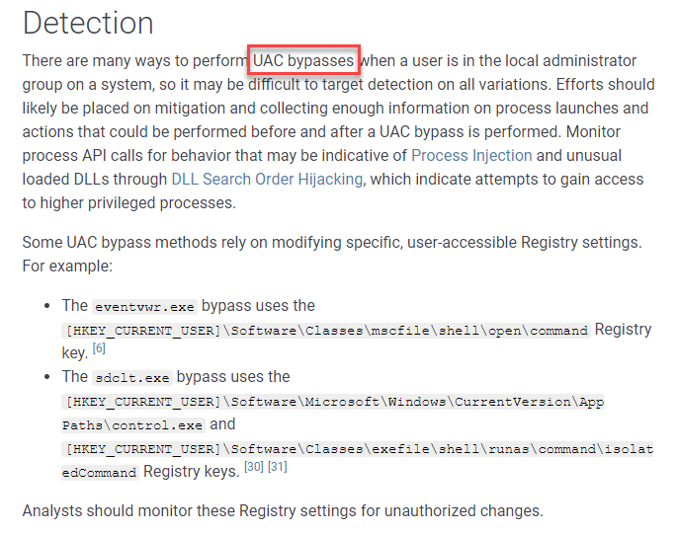
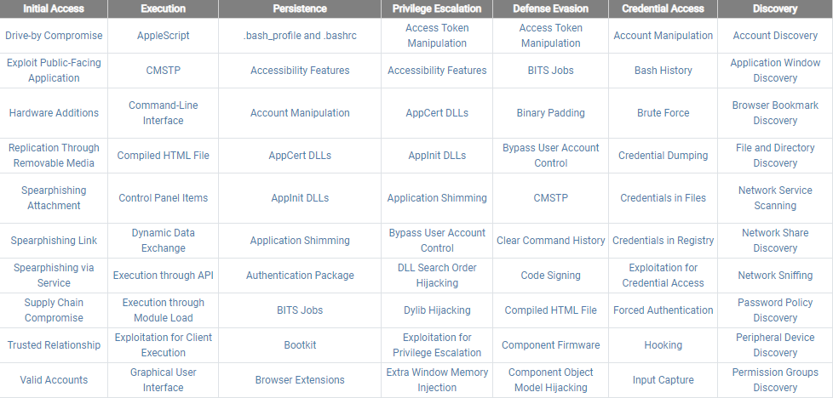
MITRE ATT&CK Matrix

Slide 11
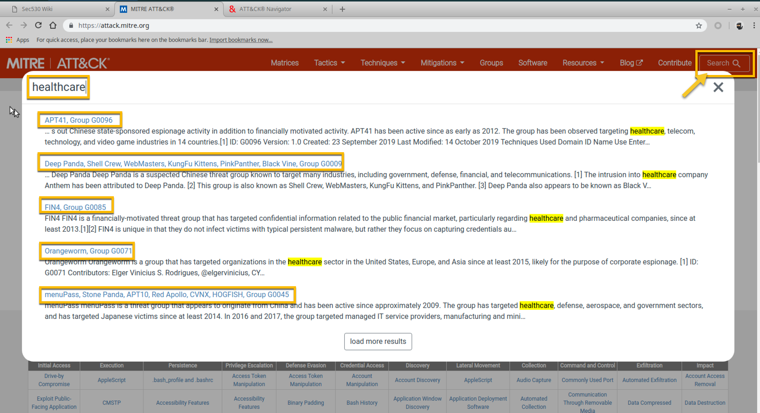
Think Red – Identifying the Adversary
A vulnerability can’t be exploited without a threat
MITRE ATT&CK provides a public repository of threat groups including ‘intent’ and ‘capabilities’
Helps us to focus on risk

Slide 12
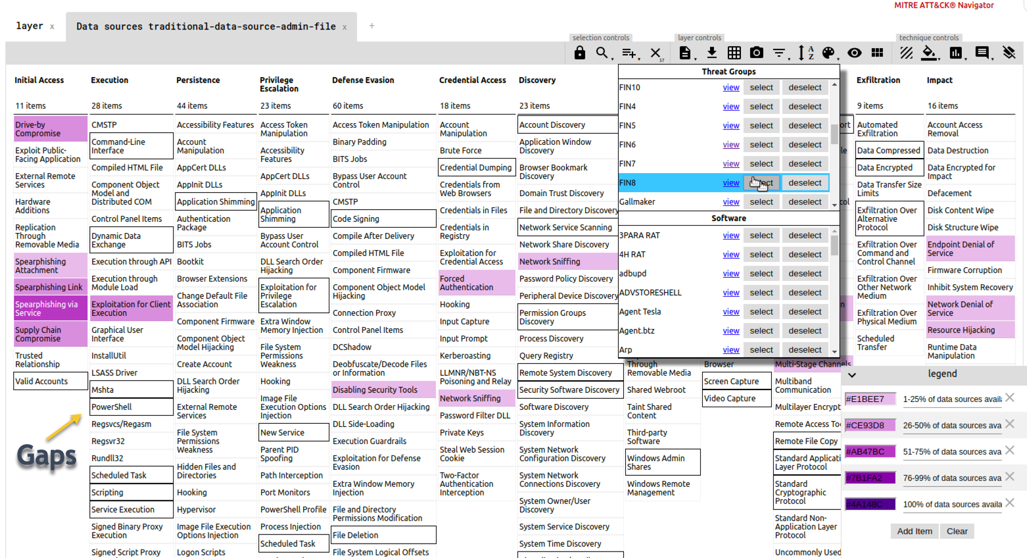
Act Blue – Identify Mismatches Between Adversary & Organization’s Strategy
Using MITRE ATT&CK Navigator we can overlay attacker’s TTPs with our organizational capabilities for visibility and detection
Identifying gaps in coverage allow us to prioritize defensive strategy based on threat intel data
#ThinkRedActBlue

Slide 13
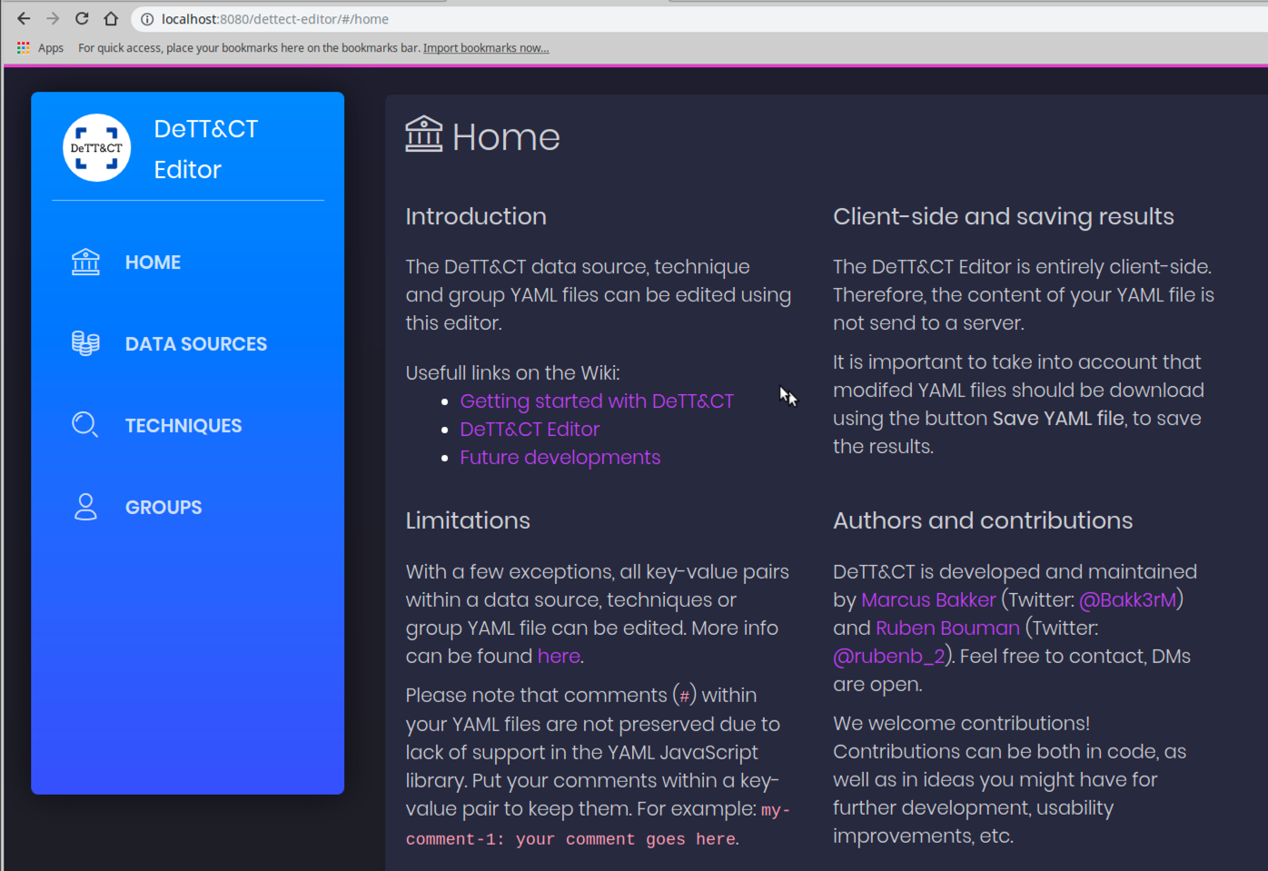
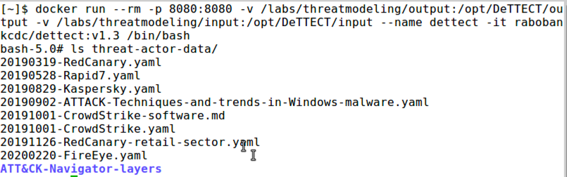
Hands On - Practical Threat Modeling with DeTTECT
DeTTECT is an open-source framework to manage, assess and compare the quality of data sources, visibility, detection and threat actors
Consists of a Python tool, YAML administration files and a built-in web-based editor

Slide 14
MITRE Technique Coverage by Data Source | MITRE DeTTECT
Example output from: python dettect.py generic –ds
Count Data Source
--------------------------------------------------
243 Command Execution
197 Process Creation
95 File Modification
89 Network Traffic Content
84 Network Traffic Flow
82 File Creation
76 OS API Execution
58 Network Connection Creation
56 Windows Registry Key Modification
50 Application Log Content
49 Module Load

Slide 15

Log Enrichment and Adding Context
Infrastructure Service Logs
Enrichment Techniques
DNS
HTTP
HTTPS
SMTP
Almost every network uses them
Lots of noise = lots of logs
Yet can be high value
Low value logs can morph into highly actionable detects
Baby Domains
Entropy Test (PH Imbalance)
Invalid Fields (wrong state)
Fuzzy Phishing

Slide 16
Ordinary to Extraordinary
query: www.google.com
query: www.google.com
subdomain: www
parent_domain: google
registered_domain: google.com
creation_date: 1997-09-15
tags: top-1m
geo.asn: Google Inc.
frequency_score: 18.2778256342
parent_domain_length: 6
Enriches to this

Slide 17
domain_stats.py
Mark Baggett developed domain_stats.py
Designed for speed and log analysis
Provides on mass domain analysis and NLP
Provides whois information like creation date
And top 1 million lookups (works with Alexa and Cisco)
$ wget -q -O- http://127.0.0.1:5730/sans.org
{"alerts":["YOUR-FIRST-CONTACT"],"category":"ESTABLISHED","freq_score":[6.2885,7.9696],"seen_by_isc":"RDAP","seen_by_web":"Fri, 04 Aug 1995 04:00:00 GMT","seen_by_you":"Sat, 07 Nov 2020 17:19:49 GMT"}

Slide 18








Log Analysis
Enterprise log collection + SIEM
Detection:
Manual log analysis and hunting
…proprietary format SIEM Analytics ☹

Slide 19
Log Signatures?
Why is it so difficult?
Even in deployments of same SIEM…
Field names differ
Data sources differ
We collect in different log formats:
Windows logs – Syslog, JSON, XML
We have no common language to specify analytics

Slide 20
What Would It Take?
SIEM Alert Engine
Source_IP
SIEM Field Normalization
SrcIP
source_ip
src.ip
Generic:
"Match if Source IP = 1.2.3.4"
SIEM Pseudo-Analytic:
if (source_ip) == 1.2.3.4 {
Alert();
}
Identical Field Normalization
(Product and Environment Specific)

Slide 21

Sigma to the Rescue!
Written by Florian Roth & Thomas Patzke
"To logs, what Snort is to network traffic and YARA is to files"
High level generic language for analytics
Best method so far of solving logging signature problem!
Enables analytics re-use and sharing across orgs
MISP compatible - share and store aligned with threat intel
Decouples rule logic from SIEM vendor and field names
Eliminates SIEM tribal knowledge
Blue teams needs this!!!

Slide 22
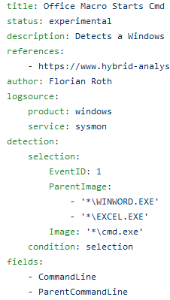
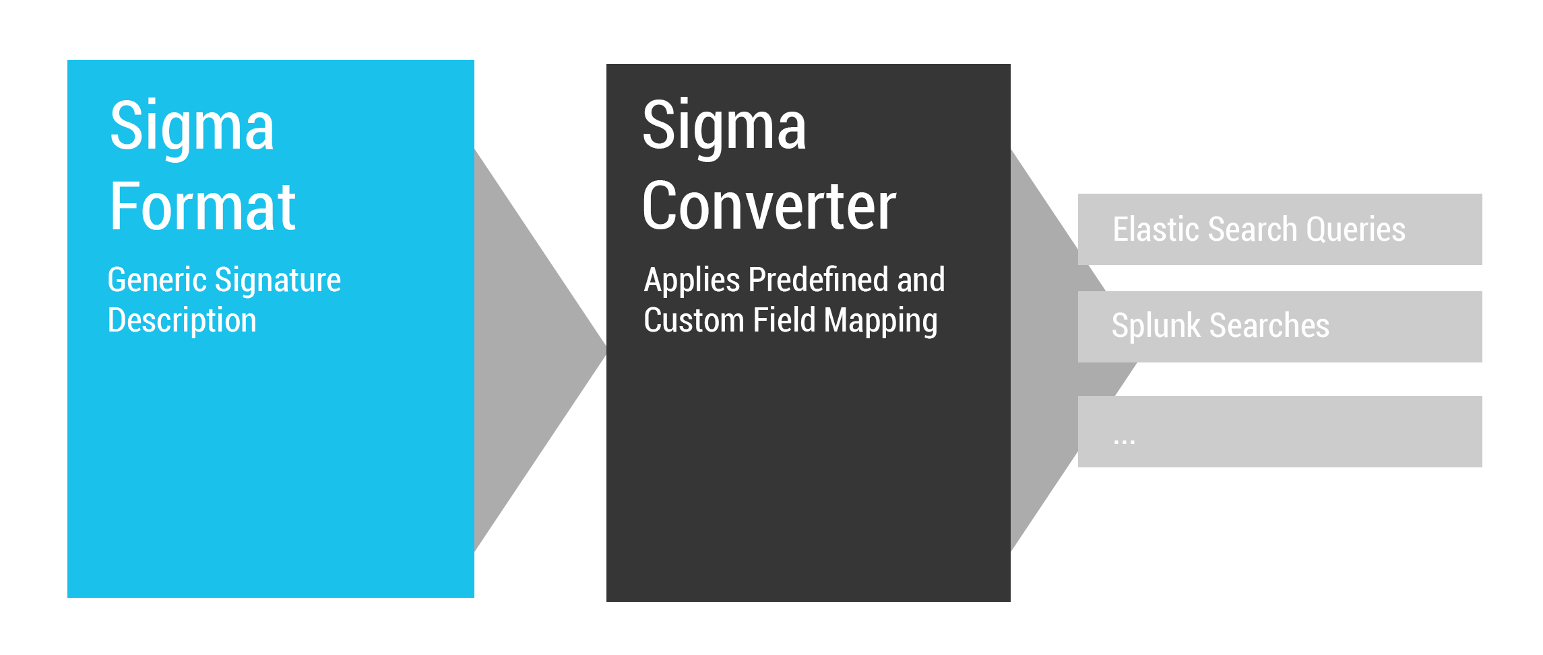
How Sigma Works

Slide 23
Conversion of Signatures to Alert Queries
Sigma Rule
Splunk
Company 1 field names
Company 2 field names
Qradar
Grep command
Elasticsearch
…
Grep
Search Query
Search Query
Company 3 field names
Search Query
…
Alert Engine
Alert Engine
Analytics
Alert Engine
Written by community
Mapping to your field names, written by you

Slide 24
Example Rule
$ cat inbound_ssh.yml
title: Inbound SSH login attempt
description: Alert when someone is trying to connect via SSH
author: Justin Henderson
status: experimental
logsource:
category: firewall
product: ufw
detection:
selection_1:
destination_port: 22
destination_ip: 192.168.42.139
condition: selection_1
Log Sample:
Nov 20 13:23:51 ubuntu kernel: [219663.525528] [UFW AUDIT] IN= OUT=ens33 SRC=192.168.42.140 DST=192.168.42.139 LEN=60 TOS=0x00 PREC=0x00 TTL=64 ID=41584 DF PROTO=TCP SPT=52900 DPT=22 WINDOW=29200 RES=0x00 SYN URGP=0
Nov 20 13:23:52 ubuntu kernel: [219664.531357] [UFW AUDIT] IN= OUT=ens33 SRC=192.168.42.140 DST=192.168.42.139 LEN=60 TOS=0x00 PREC=0x00 TTL=64 ID=41585 DF PROTO=TCP SPT=52900 DPT=22 WINDOW=29200 RES=0x00 SYN URGP=0

Slide 25
Splunk Rule Conversion
Field Mapping:
$ cat inbound_ssh.yml
title: Inbound SSH login attempt
logsource:
category: firewall
product: ufw
detection:
selection_1:
destination_port: 22
destination_ip: 192.168.42.139
condition: selection_1
$ cat splunk-sigmaui.yml
logsources:
ufw:
category: firewall
product: ufw
index: main
fieldmappings:
destination_port: destination_port
destination_ip: destination_ip
defaultindex: main
Rule Conversion:
$ ./sigmac --target splunk --config splunk-sigmaui.yml inbound_ssh.yaml
(index="main" destination_port="22" destination_ip="192.168.42.139")

Slide 26
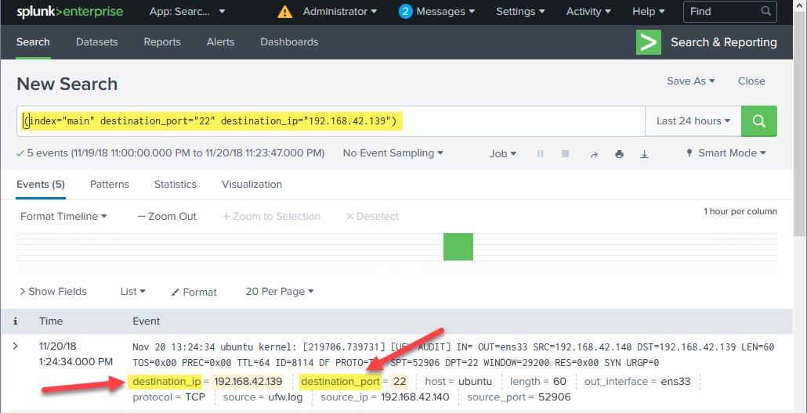
Splunk Results

Slide 27
Elasticsearch Rule Conversion
Field Mapping:
$ cat inbound_ssh.yml
title: Inbound SSH login attempt
logsource:
category: firewall
product: ufw
detection:
selection_1:
destination_port: 22
destination_ip: 192.168.42.139
condition: selection_1
$ cat elk-sigmaui.yml
logsources:
ufw:
category: firewall
product: ufw
index: firewall-ufw
fieldmappings:
destination_port: DPT
destination_ip: DST
defaultindex: firewall-ufw
Rule Conversion:
$ ./sigmac --target es-qs --config elk-sigmaui.yml inbound_ssh.yaml
(DPT:"22" AND DST:"192.168.42.139") //This would be run on the "firewall-ufw" index

Slide 28
What Was Just Done
One generic rule goes in…
Two formatted & customized search queries come out!
Sigma Rule (inbound_ssh.yml)
Splunk Format Converter
splunk_sigmaui.yml
Elasticsearch Format Converter
Search Query
elk_sigmaui.yml
Search Query
Analytics
Written by community
Customized for each deployment

Slide 29
Currently Supported Outputs
Splunk
QRadar
ArcSight
Elasticsearch (Elastalert, Query strings, DSL, Watcher, & Kibana)
Logpoint
Qualys
Windows Defender Advanced Threat Protection
PowerShell
grep
SIEM
Endpoint Query

Slide 30
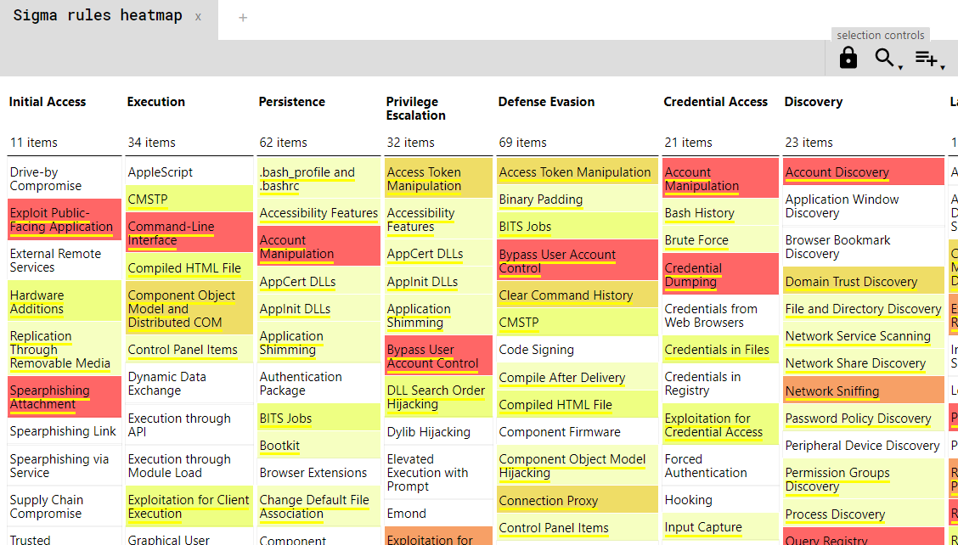
Sigma2attack
Command-line tool to generate MITRE heatmap from Sigma
Export heatmap.json
Import into Navigator
Score based on volume of rules
Useful to compare with threat models

Slide 31
SANS SEC555: SIEM with Tactical Analytics
This presentation is a demo of: SANS SEC555 SIEM with Tactical Analytics
Consider SEC555 June 28 – July 10 https://sec555.com/japan
justin@hasecuritysolutions.com

